Slide 1
Mobile controlled home lights on/off with intensity control
J. KAMESH
K.V.S.P AKHILESH
K.KEERTHANA
K.JAYASRI
V.BHARAT
M.GAYATRI
N.JAHNAVI
17L31A1244
18L31A1201
18L31A1206
18L31A1207
18L31A1209
18L31A1226
18L31A1289

Slide 2
ABSTRACT
MATERIALS
Arduino Uno
Bluetooth module – HC 05
LED’s
Jumper wires
Bread board
COST
Rs 630 /-
Rs 380 /-
Rs 10 /-
Rs 80 /-
Provided by CFI
DIMMER
RESISTORS
2 – 560 ohm
1 – 56ohm
1 - 39 ohm
1 - 330 ohm
MOC 3041
BT 138
Capacity 0.01 micro farads/630v
F1(2-10 amp)

Slide 3
INTRODUCTION
This project is a easy way of controlling home lights ON/OFF by operating from mobile itself.
It can decrease the work of humans so that they don’t need to walk and switch ON/OFF lights.
From the place where they are sitting itself, they can operate from their mobile phones. If we are new to the room,
we often find it difficult to locate the switch. Most of the times,
many of us forget to switch of the lights leaving the room in which we stay most of the time.
This results in unnecessary power wastage.
Therefore, a mobile control can turn on when the person enters and off when the person leaves the room.

Slide 4
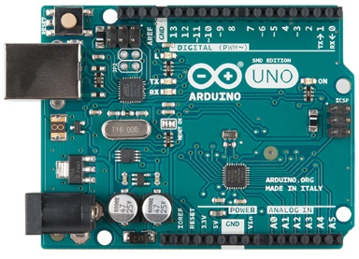
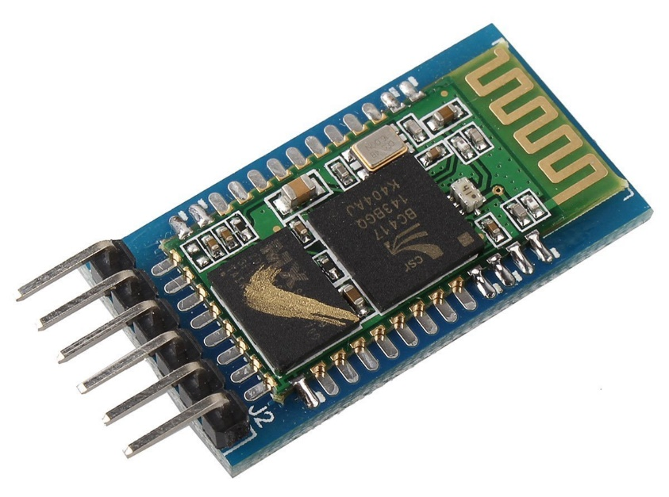
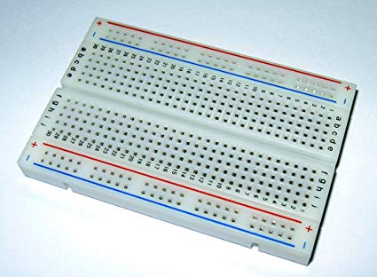
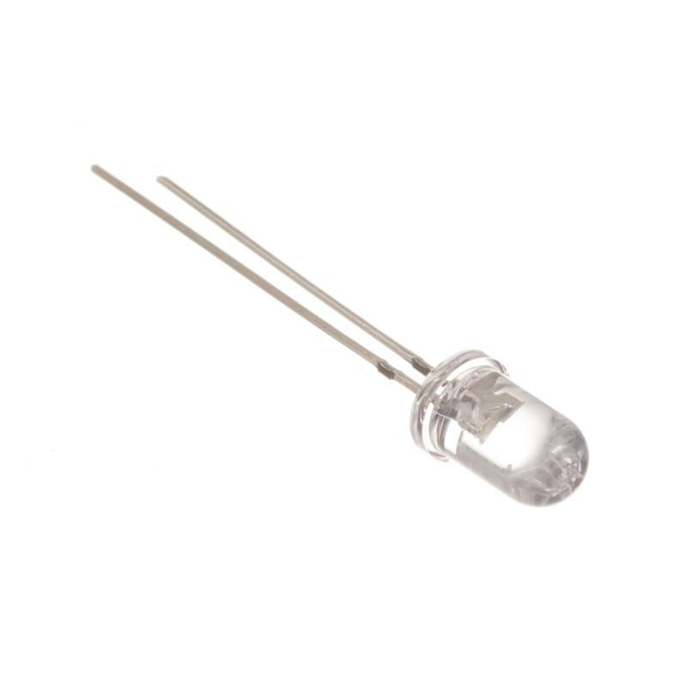
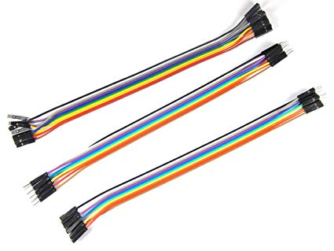
ARDUINO UNO
BLUETOOTH MODULE HC-05
Bread board
LED
JUMPER WIRES

Slide 5
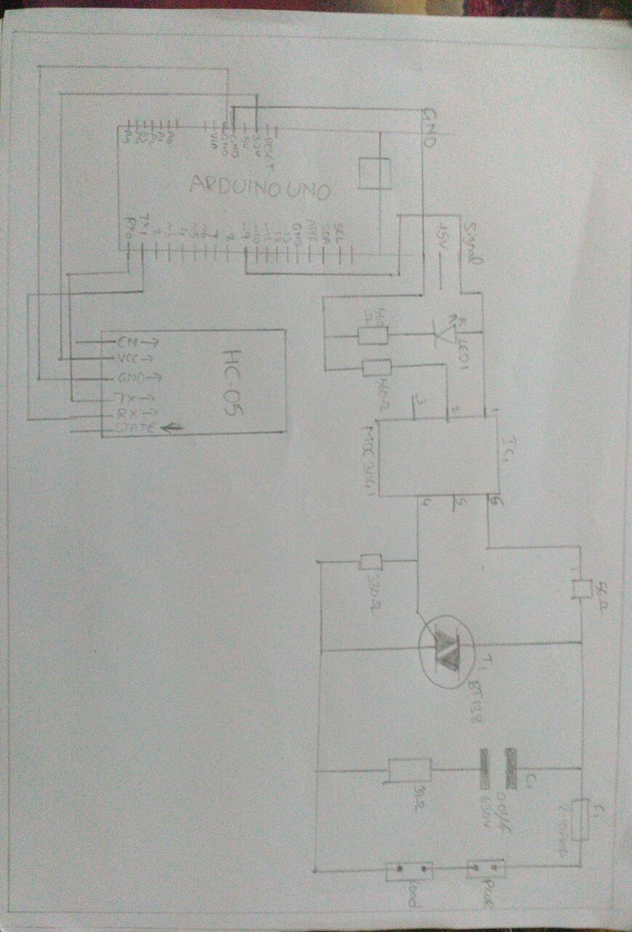
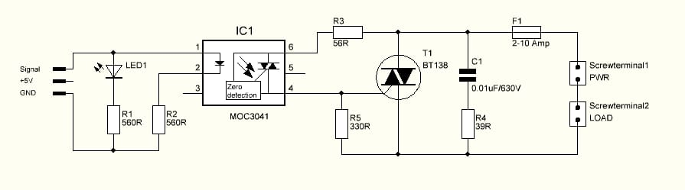
CIRCUIT FOR BOTH AC AND DC COMPONENTS
DIMMER CIRCUIT

Slide 6
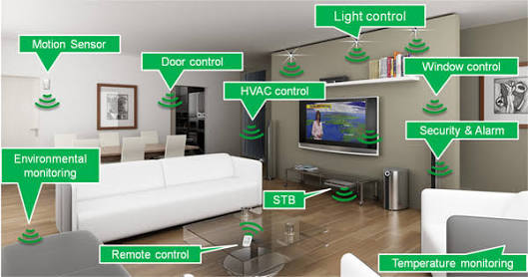
FUTURE SCOPE - HOME AUTOMATION
Home automation or smart home is BUILDING AUTOMATION for the home. It involves the control and automation of lighting, heating (such as SMART THERMOSTATS), ventilation, air conditioning (HVAC), and security, as well as HOME APPLIANCES such as washer/dryers, ovens or refrigerators/freezers. WI-FI is often used for remote monitoring and control. Connected home devices of today all fall into one of the following sectors:
- HEM (Home Energy Management) - Home Automation - Smart Meters - Home Security - Home medical monitoring - OTT & VOD - Online games
Sometimes, the term
‘home automation’ is used to
encompass and refer to all of
them.

Slide 7
This project helps to control the electrical loads with the help of android application. The electrical loads are controlled based on Bluetooth input signal. This input signal is received from the android device. Many times it becomes too tiring to operate the electrical switches manually every now and then. This is a big problem especially in case of aged or handicapped people. This system solves the issue by interfacing a unit with home appliances that switches these loads based on the input received from android device.
OUTCOME

Slide 8


